Slide 1
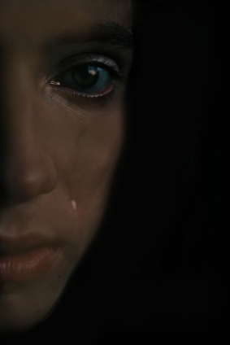
“Digging Up the Past” to Teach
About Race and Social Action:
The Mary Turner Project (MTP)
Association for Applied & Clinical Sociology
2008 Annual Meeting - Jacksonville, FL
Presenter: Mark Patrick George, Ph.D.
Valdosta State University

Slide 2
What is the MTP and How Did It Begin?
The Mary Turner Project is a diverse collective of Valdosta State University students, faculty, and local community members. The group formed in the Fall of 2007 in response to a reading assignment given in a Sociology Course on Race and Ethnic Relations. That assignment centered on the lynching “rampage” (Meyers, 2006) that took place in May of 1918 in Brooks and Lowndes Counties, Counties many of the students originate from or know. That rampage or racial terrorism resulted in the deaths of 13 people.
One of the victims was a 28 year old woman named Mary Turner who was 8 months pregnant at the time. Because she publicly objected to the lynching of her husband Hayes, a mob took Mrs. Turner to a place called Folsom Bridge to be killed. At that bridge, the mob tied her by her ankles, hung her upside down from a tree, poured gasoline on her and burned off her clothes. One member of the group then cut her stomach open and her unborn child dropped to the ground where it was reportedly stomped on and crushed. Her body was then riddled with gunfire from the mob. Later that evening she was buried in a makeshift grave marked with only a "whiskey bottle" with a "cigar" stuffed in its neck (White, 1918).
After students learned about this local history and the fact that; there is ongoing silence/ignorance about these events in the community; no one was ever held accountable for the murders; and to date, not one historical marker exists to acknowledge these heinous acts of racial terrorism, they were moved to do more. Consequently students and faculty beginning having bi-monthly meetings to strategize about what could be done to acknowledge these events and raise local/national awareness about them. Thus, the Mary Turner Project was born.

Slide 3
Tangible Outcomes of the MTP
Traveled Together to Campground Church Site
Developed and Launched Website (www.maryturner.org)
Began Fundraising for the Installation of a Historical Marker
Created Facebook Group and MySpace Page
Developed Brochure for Public Dissemination
Conducted Further Research on These Events
Made Contact with and Share Resources with Descendants
Done Public Awareness Raising (Campus and Community)
Started Preproduction of Video/Documentary
Petitioned for SGA Recognition

Slide 5
Pedagogical Outcomes of the MTP
Created a Space for Cross-Racial Dialogue and Interaction
Humanized and Made History “Local and Personal”
Leadership Development & Student Empowerment
Research Skills Development
Bridged the Gap Between the Academy and Community
Moved Student from the Head to the Heart - Social Action

Slide 6
Implications

